Slide 1
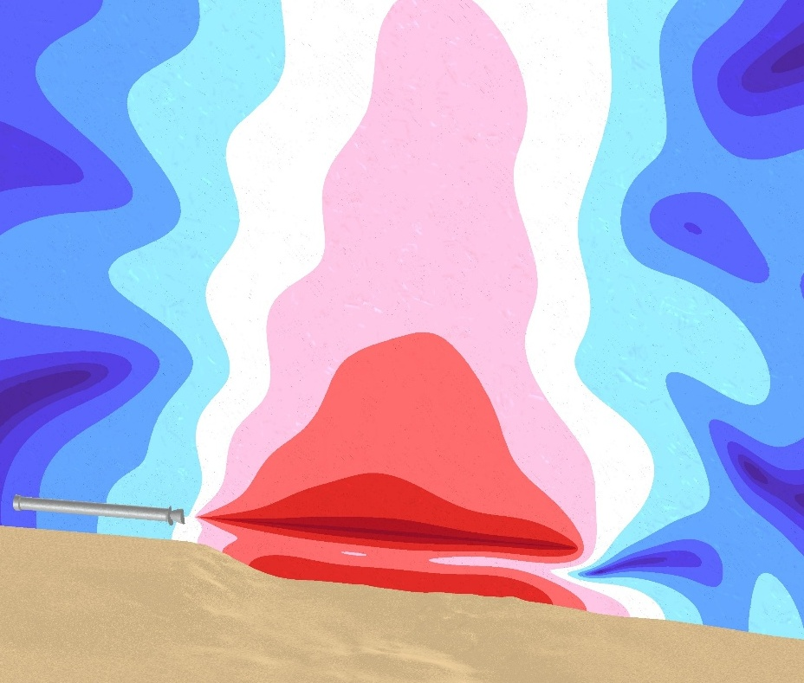
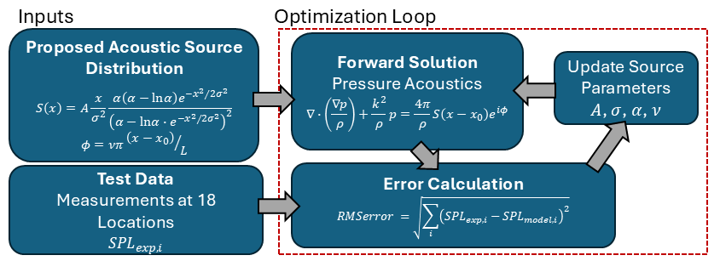
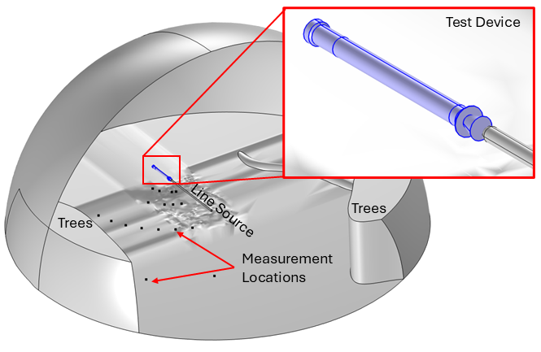
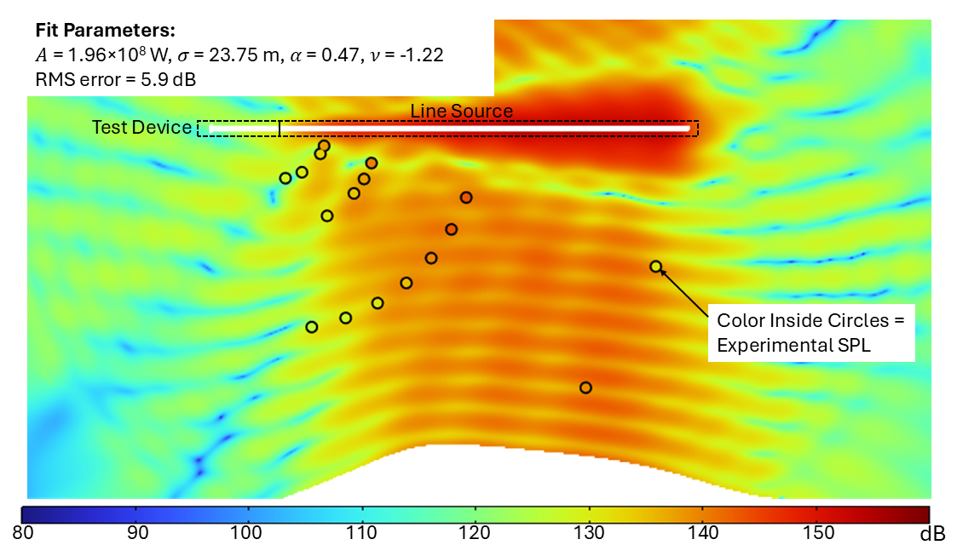

Determination of Acoustic Source Distribution from a Test Rocket: Inverse Analysis Using SPL Measurements
Accurate quantitative representation of the acoustic source from rocket exhaust enables identification of potential issues earlier in the design process
Sound pressure level (SPL) measurements in the vicinity of a test rocket are used in an inverse analysis to achieve this
M. J. Varady¹, L. T. Gritter¹, M. J. Casiano², A. R. Murdaugh², S. R. Fishbach²
AltaSim Technologies, LLC, Columbus, OH
NASA Marshall Space Flight Center, Huntsville, AL
Abstract
Rocket exhaust during liftoff and landing generates intense acoustic pressure loads that can threaten structural integrity, onboard components, and crew health. Accurate prediction of these loads enables more robust vehicle and infrastructure design earlier in the design cycle, but the spatial distribution of acoustic sources within the exhaust plume has not been adequately quantified. To address the current knowledge gap, an inverse methodology was developed in COMSOL Multiphysics to determine the parameters of a line source distribution using a pressure level (SPL) measurements at several locations surrounding a test rocket.
FIGURE 1. Flowchart of solution methodology.
Methodology
The acoustic source at the rocket exhaust was approximated as a distributed line source with a modified Rayleigh distribution with four adjustable parameters¹. The forward pressure acoustics problem was solved with a full FEM formulation or a hybrid FEM-BEM formulation in which FEM was used only in the immediate vicinity of the line source and BEM to propagate the solution outside of this region. Frequency-dependent impedance values were obtained from the literature for the ground² and tree line^{3.} The Optimization Module was used with the COBYLA global optimization method to find the values of the line source parameters that minimized the sum of square errors between the model-predicted and experimentally measured SPL at all 18 measurement points at frequencies up to 100 Hz.
FIGURE 2. Model Geometry showing test device, line source, and measurement locations
Results
The modified Rayleigh line source distribution matched the experimental SPL measurements within a total error of 5.9 dB over the 18 measurement points at f = 50 Hz. In the plot, the experimental SPL values are represented inside the black circles on the same color scale as the model results to facilitate visual assessment of the fit.
Future work may include using the optimization framework developed here to explore alternative functional forms of the source distribution, sensitivity to model inputs (e.g., ground and tree-line impedances), and improved sensor placement in the experiments. For example, the error introduced by uncertainty in the model representation of ground contour and impedance may be minimized by placing the sensors at a higher elevation.
FIGURE 3. Sound pressure level for f = 50 Hz at optimized source parameter values. Color inside circles represents the experimentally measured SPL
K. L. Gee, T. B. Neilsen, M. M. James, “Including source correlation and atmospheric turbulence in a ground reflection model for rocket noise”, Proc. Mtgs. Acoust. 2014, 22 (1), 040001.
K. Attenborough, I. Bashir, S. Taherzadeh, “Outdoor ground impedance models”, J. Acoust. Soc. Am., 2011, 129 (5), pp. 2806–2819.
K. Attenborough, S. Taherzadeh, “Sound propagation through forests and tree belts. In: Proceedings of the Institute of Acoustics, 2016, 38(1) pp. 114–125.

