Slide 1
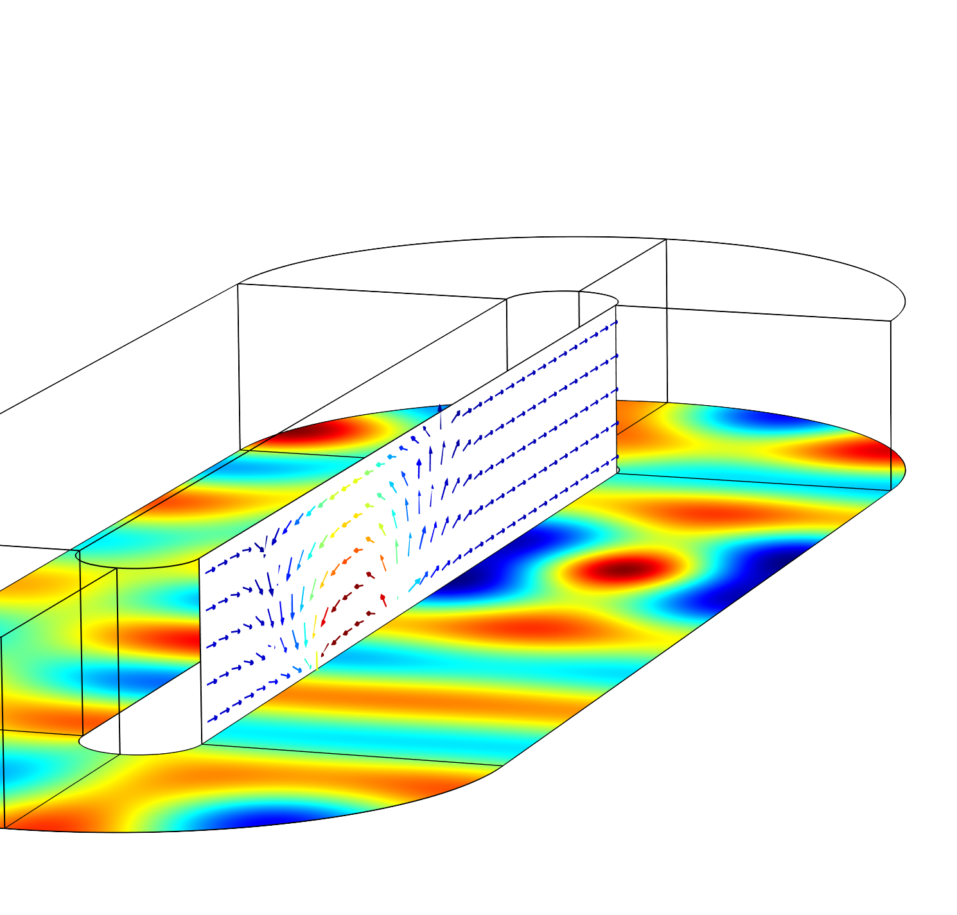
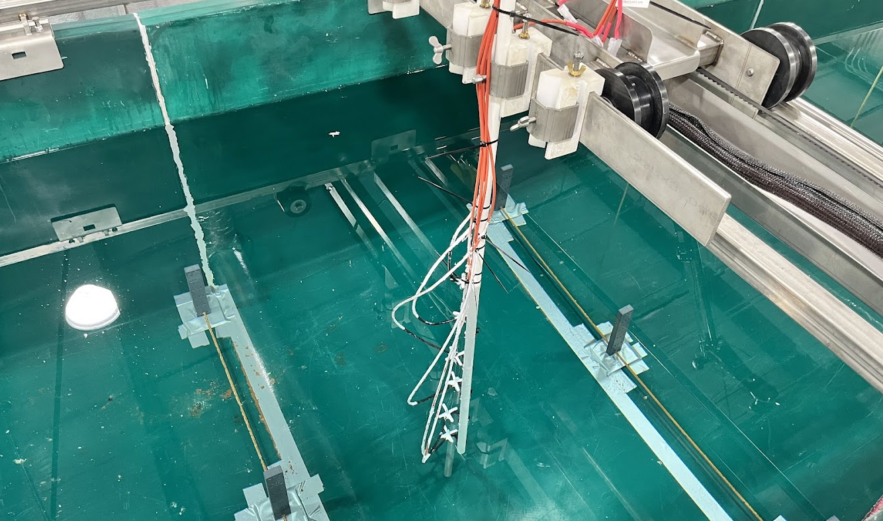
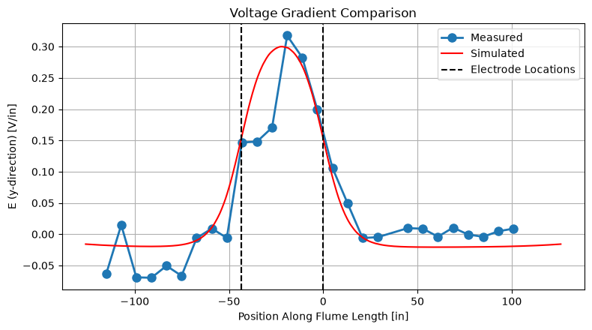


Analysis of Combined Electric and Acoustic Fish Deterrents
This work investigates the incorporation of electric and acoustic sources within a single domain using COMSOL Multiphysics® simulations and laboratory experiments.
Nathanael J. Frisch^{1,2}, Caylin A. Hartshorn^{1,2}, Aaron C. Urbanczyk^{1,3}, William T. Slack^{1,3}, Christa M. Woodley^{1,3}
1. U.S. Army Corps of Engineers, Engineer Research and Development Center
2. Cold Regions Research and Engineering Laboratory, Hanover, NH, USA
3. Environmental Laboratory, Vicksburg, MS, USA
Introduction & Goals
The rapid spread of aquatic invasive species (AIS) can cause substantial ecological and economic damage (Ref. 1). To limit the spread of AIS while still allowing for navigation, managers rely on nonstructural deterrents (NSDs). Two are of particular interest to this research: electric deterrent systems (EDSs) and underwater acoustic deterrent systems (uADSs). While uADS has undergone less field validation, it offers substantial potential for deterring AIS while avoiding several of the key limitations associated with EDS. These considerations are reflected in ongoing USACE efforts, including, among others, the Brandon Road Interbasin Project, where uADS and EDS are planned for deployment in close proximity as complementary deterrent technologies (Ref. 2). An Electrical–Underwater Acoustic Deterrent System (EuADS) has no known prior deployment and is therefore an undertaking without precedent. Our research is seeking to answer: How can electric and acoustic deterrents be used in tandem to capitalize on the strengths of each?
Methodology
Because this is the first-of-its-kind system, we need a fundamental understanding of how the two technologies combine to affect fish and how they can be operated together effectively. To develop this understanding, we are constructing a scaled fish flume with both deterrent systems. We used COMSOL to predict the drivers of fish deterrence (the electric and acoustic fields) within this single domain. The Electric Currents physics interface was chosen to model the EDS, and the Pressure Acoustics, Frequency Domain physics interface was chosen to model the uADS. We developed a theoretical framework to directly compare laboratory measurements to COMSOL predictions. Our comparison is limited to the electric field, while the simulation results include both acoustic and electric fields.
FIGURE 1. Array of triaxial receivers installed in the fish flume, centered between two electrodes.
Results
After postprocessing the measured data, we used the COMSOL API, wrapped by the MPh Python library, to evaluate the results dataset. We mapped the physical locations to the COMSOL domain, then evaluated the voltage at points approximately +1 in. and −1 in. from those locations, corresponding to the voltage difference physically measured with the receivers. The resulting comparison is shown in Figure 2. Though there is an asymmetry of the measured data around the center point of the electrode, the electric-field mapping shows an agreement in peak location, peak magnitude, and electric-field shape with the COMSOL model.
FIGURE 2. Comparison of the simulated data to the data collected in the physical fish flume. The voltage gradient is computed across 2 in., corresponding to the probe size.
T. B. Lauber et al., “The effects of aquatic invasive species on recreational fishing participation and value in the Great Lakes: Possible future scenarios”, 2020
Will County, Illinois, “GLMRIS-BR: Main Report”, 2018

