Slide 1
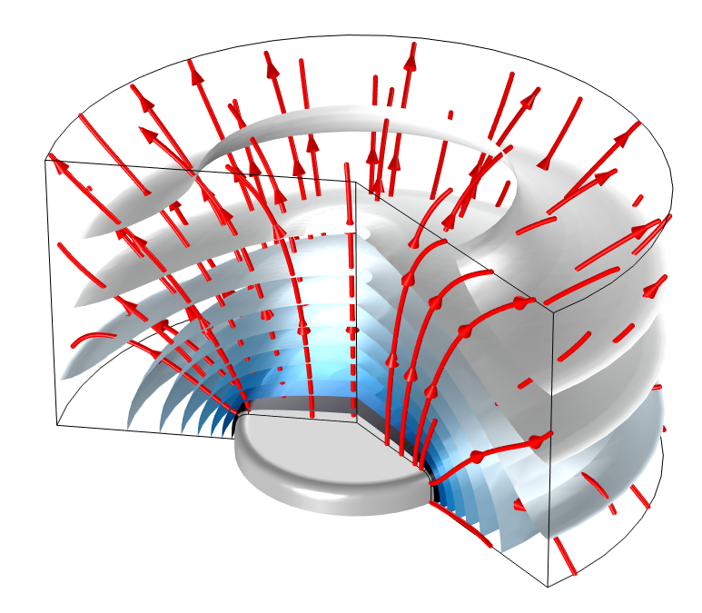
Modeling of Stefan Flow due to Evaporation from a Water Surface

Slide 2
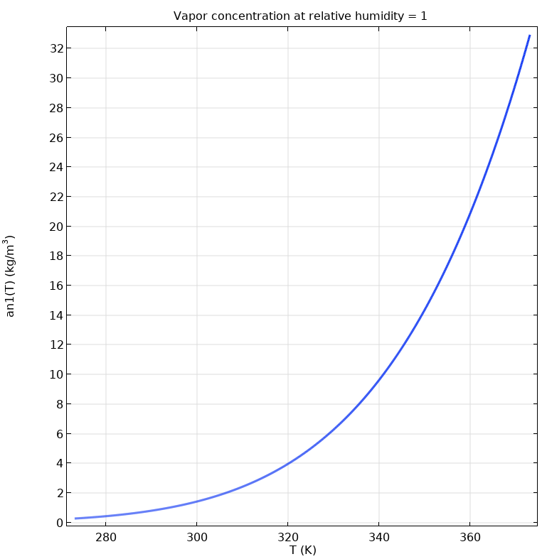
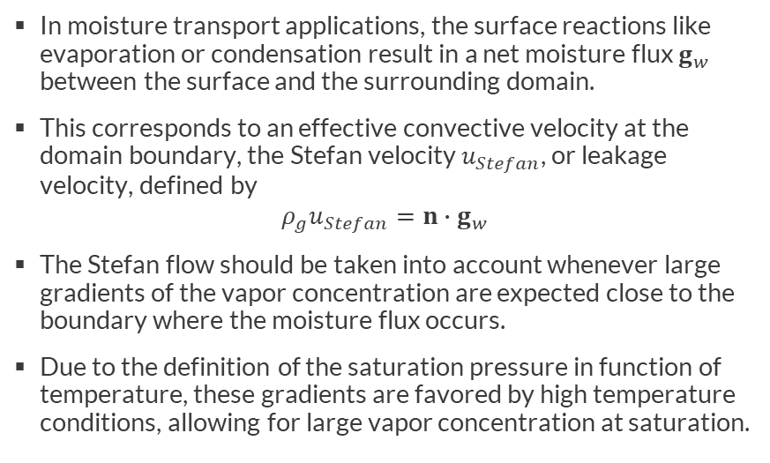
Background
In moisture transport applications, the surface reactions like evaporation or condensation result in a net moisture flux $g_{w}$ between the surface and the surrounding domain.
This corresponds to an effective convective velocity at the domain boundary, the Stefan velocity $u_{Stefan}$, or leakage velocity, defined by
$${ρ_{g}u}_{Stefan}=n∙g_{w}$$
The Stefan flow should be taken into account whenever large gradients of the vapor concentration are expected close to the boundary where the moisture flux occurs.
Due to the definition of the saturation pressure in function of temperature, these gradients are favored by high temperature conditions, allowing for large vapor concentration at saturation.
Vapor concentration at saturation in function of the temperature (analytical computation)

Slide 3
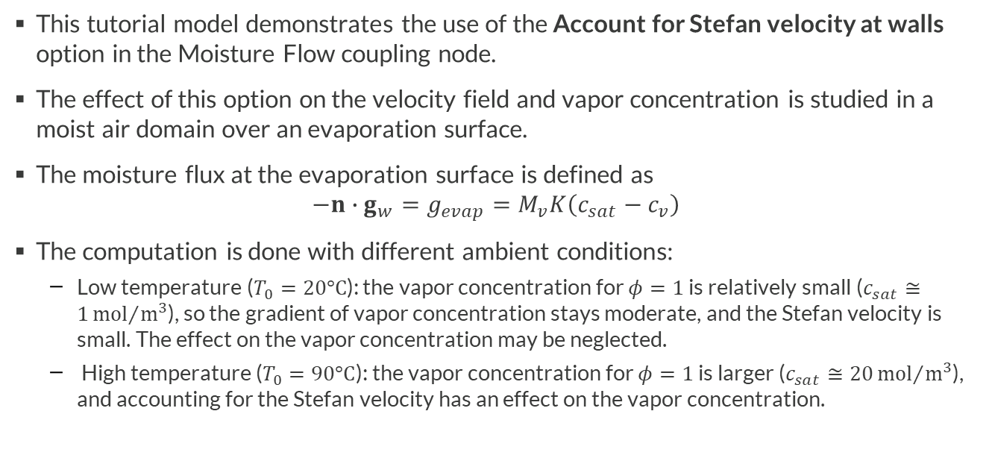
Motivation
This tutorial model demonstrates the use of the Account for Stefan velocity at walls option in the Moisture Flow coupling node.
The effect of this option on the velocity field and vapor concentration is studied in a moist air domain over an evaporation surface.
The moisture flux at the evaporation surface is defined as
$$−n∙g_{w}=g_{evap}=M_{v}K\left(c_{sat}−c_{v}\right)$$
The computation is done with different ambient conditions:
  Low temperature ($T_{0}=20°C$): the vapor concentration for $φ=1$ is relatively small ($c_{sat}≅1{mol}/{m^{3}}$), so the gradient of vapor concentration stays moderate, and the Stefan velocity is small. The effect on the vapor concentration may be neglected.
  High temperature ($T_{0}=90°C$): the vapor concentration for $φ=1$ is larger ($c_{sat}≅20{mol}/{m^{3}}$), and accounting for the Stefan velocity has an effect on the vapor concentration.

Slide 4
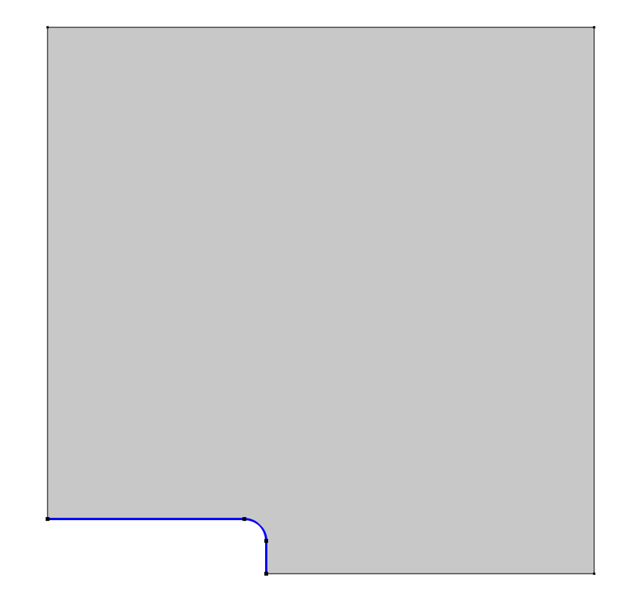


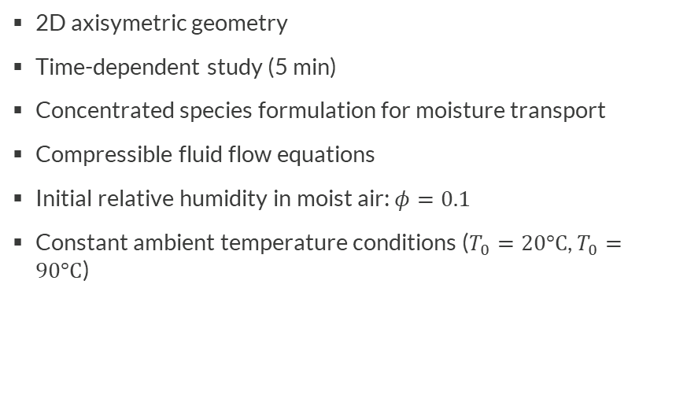




Model Definition
Symmetry axis
Moist air
$$φ$$
Evaporation surface ($φ$=1)
2D axisymetric geometry
Time-dependent study (5 min)
Concentrated species formulation for moisture transport
Compressible fluid flow equations
Initial relative humidity in moist air: $φ=0.1$
Constant ambient temperature conditions ($T_{0}=20°C$, $T_{0}=90°C$)
$${−n∙g_{w}=g}_{evap}$$
Model definition for moisture transport
Moist air
$$u, p_{A}$$
Wall ($u$=0)
$$u_{Stefan}$$
Model definition for fluid flow

Slide 5
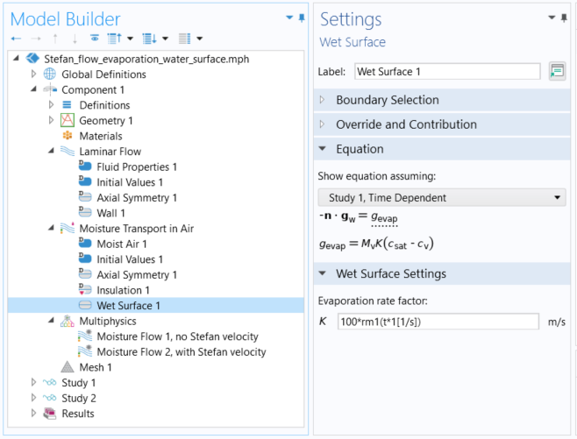

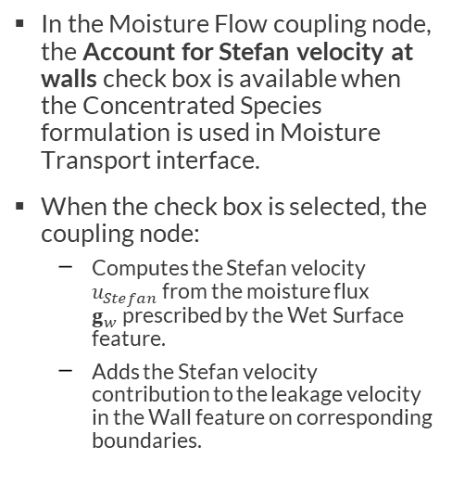
Implementation
Settings window of the Wet Surface feature
Moisture flux
In the Moisture Flow coupling node, the Account for Stefan velocity at walls check box is available when the Concentrated Species formulation is used in Moisture Transport interface.
When the check box is selected, the coupling node:
  Computes the Stefan velocity $u_{Stefan}$from the moisture flux $g_{w}$prescribed by the Wet Surface feature.
  Adds the Stefan velocity contribution to the leakage velocity in the Wall feature on corresponding boundaries.
Stefan velocity
Settings window of the Moisture Flow coupling node

Slide 6
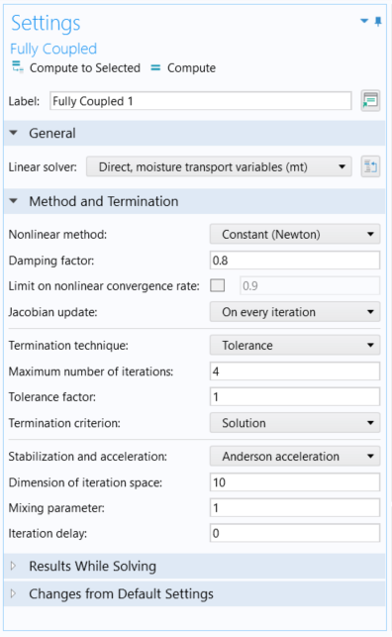
Implementation
Study 1: enables Moisture Flow 1, with Account for Stefan velocity at walls not selected
Study 2: enables Moisture Flow 2, with Account for Stefan velocity at walls selected
Study 1 & 2: Fully coupled solver for better convergence
  Damping: 0.8
  Jacobian update: On every iteration
  Stabilization and acceleration: Anderson acceleration
Default mesh
In the Wet Surface feature, ramp applied on evaporation rate for consistent initialization: K=100*rm1(t*1[1/s])
Settings window of the Fully Coupled node in Study 1 and Study 2

Slide 7
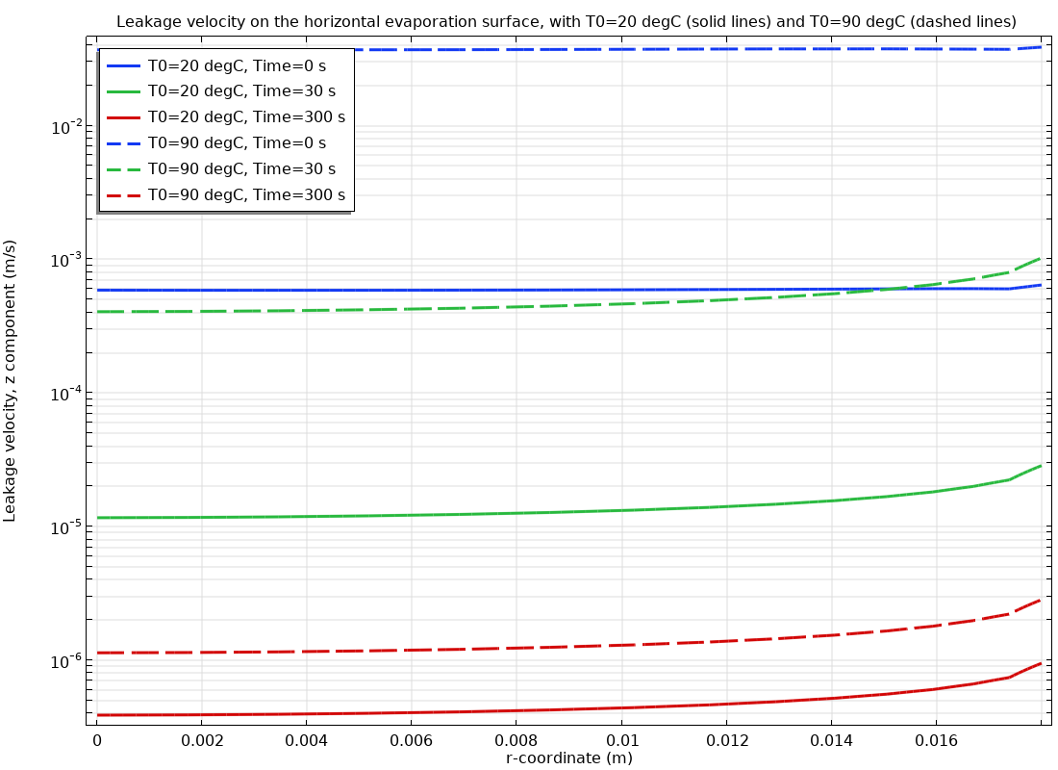
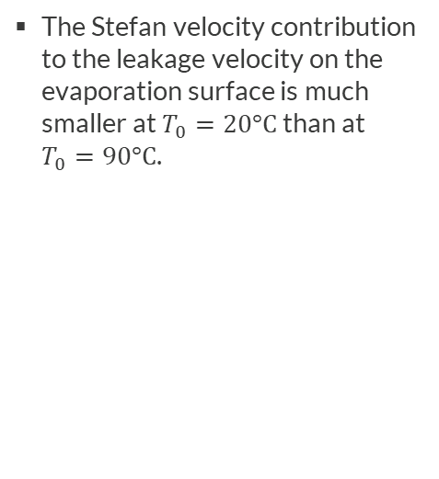
Results
The Stefan velocity contribution to the leakage velocity on the evaporation surface is much smaller at $T_{0}=20°C$ than at $T_{0}=90°C$.

Slide 8
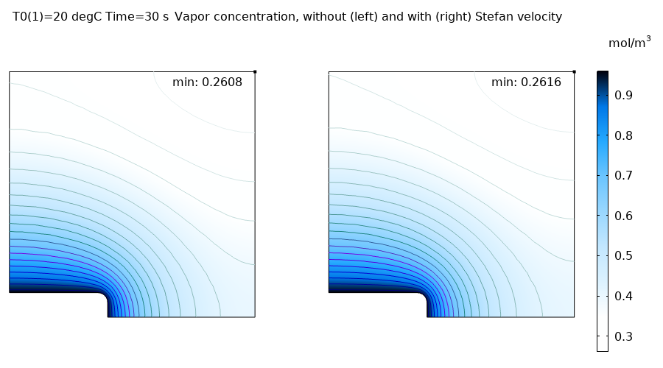
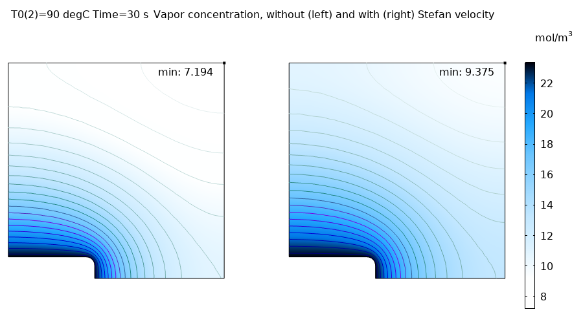
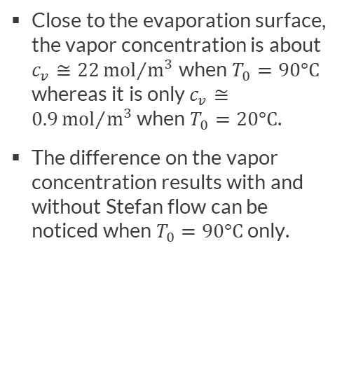
Results
Close to the evaporation surface, the vapor concentration is about $c_{v}≅22{mol}/{m^{3}}$when $T_{0}=90°C$ whereas it is only $c_{v}≅0.9{mol}/{m^{3}}$ when $T_{0}=20°C$.
The difference on the vapor concentration results with and without Stefan flow can be noticed when $T_{0}=90°C$ only.
Vapor concentration distribution when T0=20°C
Vapor concentration distribution when T0=90°C

Slide 9
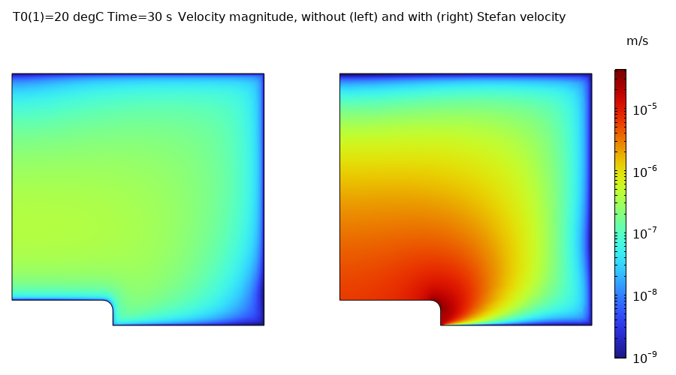
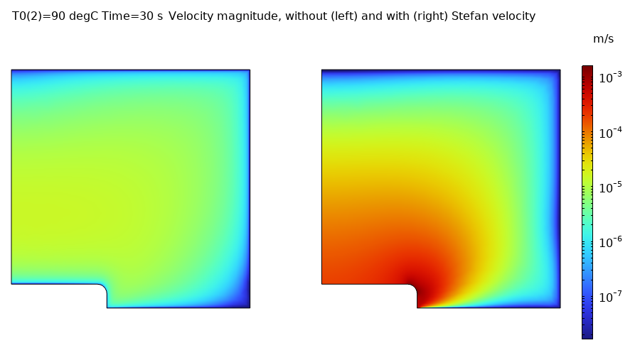
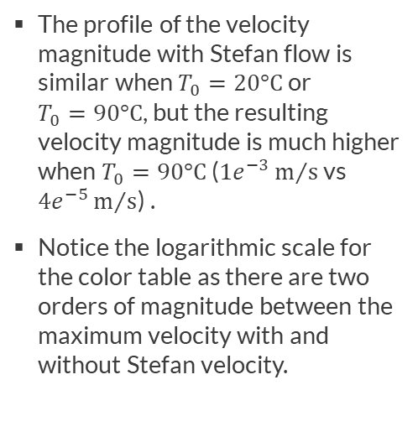
Results
The profile of the velocity magnitude with Stefan flow is similar when $T_{0}=20°C$ or
$T_{0}=90°C$, but the resulting velocity magnitude is much higher when $T_{0}=90°C$ ($1e^{−3}m/s$ vs $4e^{−5}m/s$) .
Notice the logarithmic scale for the color table as there are two orders of magnitude between the maximum velocity with and without Stefan velocity.
Velocity magnitude distribution when T0=20°C
Velocity magnitude distribution when T0=90°C

Slide 10
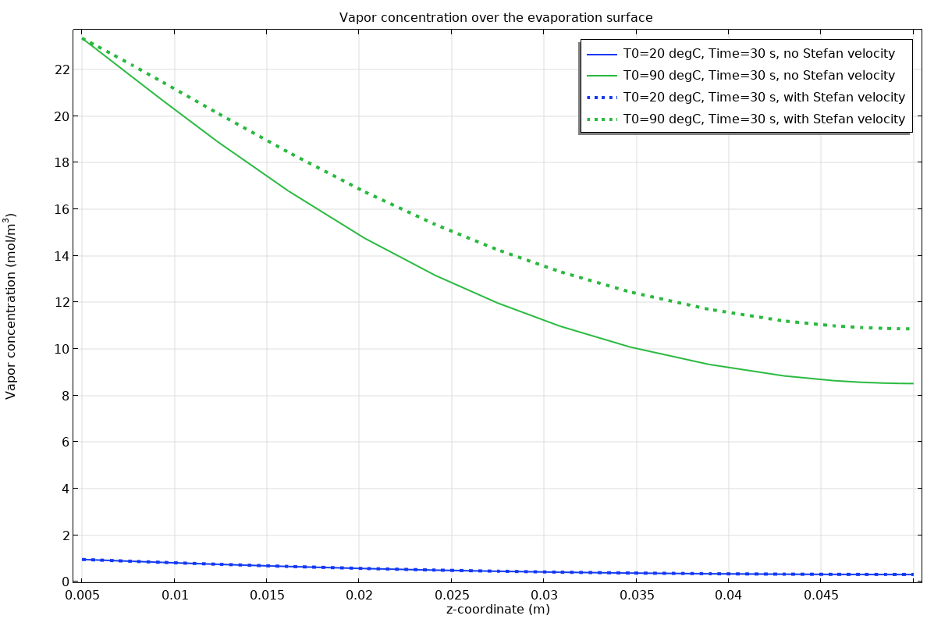
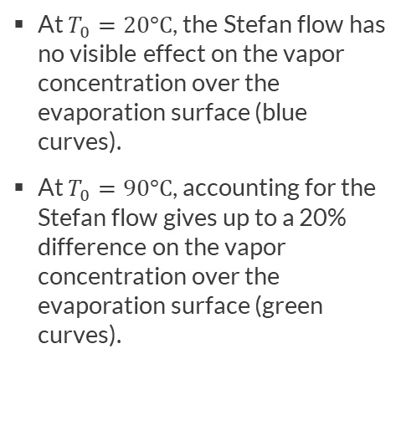
Results
At $T_{0}=20°C$, the Stefan flow has no visible effect on the vapor concentration over the evaporation surface (blue curves).
At $T_{0}=90°C$, accounting for the Stefan flow gives up to a 20% difference on the vapor concentration over the evaporation surface (green curves).

Slide 11
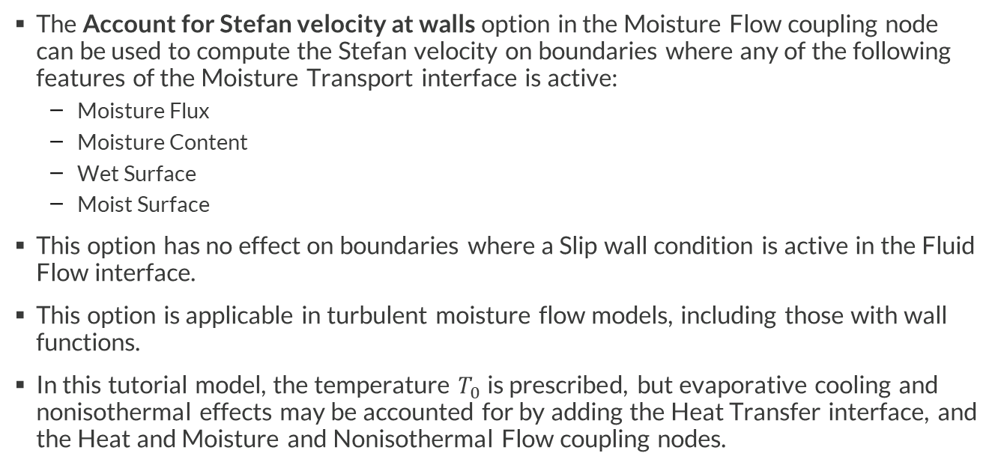
Concluding Remarks
The Account for Stefan velocity at walls option in the Moisture Flow coupling node can be used to compute the Stefan velocity on boundaries where any of the following features of the Moisture Transport interface is active:
  Moisture Flux
  Moisture Content
  Wet Surface
  Moist Surface
This option has no effect on boundaries where a Slip wall condition is active in the Fluid Flow interface.
This option is applicable in turbulent moisture flow models, including those with wall functions.
In this tutorial model, the temperature $T_{0}$ is prescribed, but evaporative cooling and nonisothermal effects may be accounted for by adding the Heat Transfer interface, and the Heat and Moisture and Nonisothermal Flow coupling nodes.

